Slide 1

Dsc 530 Final project –Tornadoes among us!
Anthony Wilson

Slide 2
Have tornadoes cost more in property damage over the last ten year?
Hypothesis/Question

Slide 3
Variables
YEAR – Four-digit number for year the tornado happened (Ex. 2019)
DAMAGE_PROPERTY – Estimated property damage in dollars
DAMAGE_BUCKET – Binned estimation of Damaged Property
'<= 200000','<= 400000','<= 600000','<= 800000','<= 1000000','<= 1200000','<= 1400000','<= 1600000','<= 1800000','<= 2000000','<= 2200000','<= 2400000','<= 2600000’
TOR_F_SCALE – Fujita scale that measures the strength of the tornado, based on the amount of damage caused by tornado
EF0 – Light Damage (40 – 72 mph),
EF1 – Moderate Damage (73 – 112 mph)
EF2 – Significant damage (113 – 157 mph)
EF3 – Severe Damage (158 – 206 mph)
EF4 – Devastating Damage (207 – 260 mph)
EF5 – Incredible Damage (261 – 318 mph)a scale of tornado storm severity
EFU/NA – Missing/unidentified
TOR_LENGTH – Length of tornado in miles, when it touched the ground
TOR_WIDTH – Width of the tornado in feet while on the ground
Notes:
Data is gathered from National Centers for Environmental Information. There were 70 total files brought in. DAMAGE_PROPERTY based on the original value where the set as 12K or 3M. TOR_F_SCALE is each Fujita categorical variable has its own column and sum, when aggregating by YEAR. No need to display because we will get the same results.

Slide 4
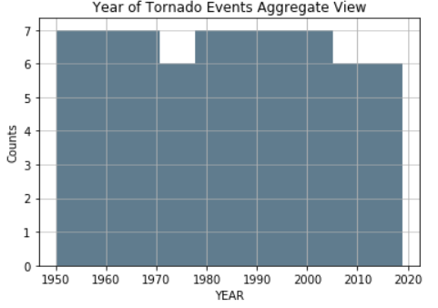
YEAR
count: 67
mean: 1983.835821
std: 20.197207
min: 1950
0.25: 1966.5
0.5: 1984
0.75: 2000.5
max: 2019
Notes:
Variables are set around year. I aggregate them based on year and calculate sums, means, etc.….
The counts are binned together hence the some are 7 and not 6.
Since these variables are aggregated by year the mode is repeated 67 times.

Slide 5
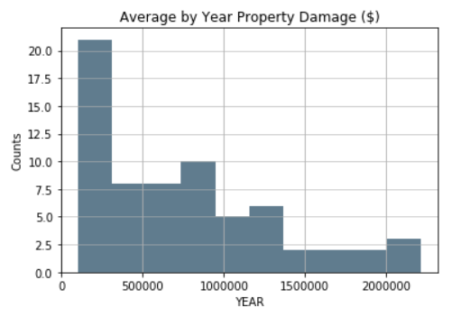
DAMAGE_PROPERTY
count: 67
mean: 740082.16
std: 567117.99
min: 99852.5
0.25: 242397.53
0.5: 589639.81
0.75: 1058827.41
max: 2214829.58
Notes:
There were outliers past 2.2 million that were causing the data to be skewed with a high kurtosis. I dropped those values and the skew and kurtosis dropped down with it.
Skew prior: 2.28
Kurtosis prior: 7.52
Skew after: 0.96
Kurtosis after: 0.09

Slide 6
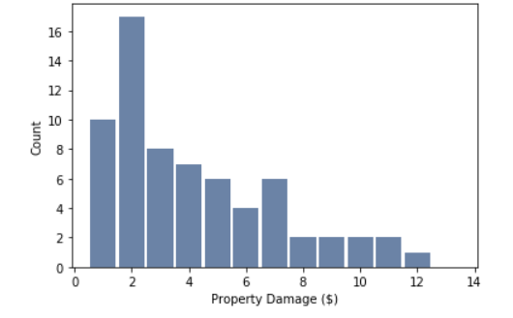
DAMAGE_BUCKET
id:1 bucket: <= 200000
id:2 bucket: <= 400000
id:3 bucket: <= 600000
id:4 bucket: <= 800000
id:5 bucket: <= 1000000
id:6 bucket: <= 1200000
id:7 bucket: <= 1400000
id:8 bucket: <= 1600000
id:9 bucket: <= 1800000
id:10 bucket: <= 2000000
id:11 bucket: <= 2200000
id:12 bucket: <= 2400000
id:13 bucket: <= 2600000
count: 67
unique: 12
top: 2
freq: 17
Notes:
I used this so that I could create a cdf for DAMAGE_BUCKET, making it much easier to read the graphs.

Slide 7
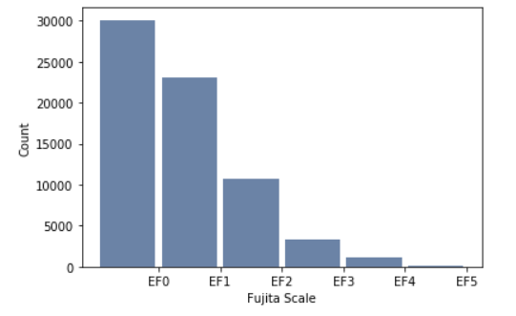
TOR_F_SCALE
count: 68456
unique: 6
top: EF0
freq: 30087
Notes:
I am showing the full data set from here, then I will show the transposed values that are used in the aggregated data frame. Previously we had missing values and a value EFU, which I interpreted as unidentified, so I dropped. I treated the EFU like missing values, it would be hard to predict something with a missing value that is key.

Slide 8
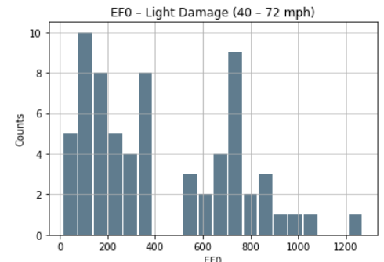
efo
count: 67
mean: 424.93
std: 311.62
min: 13
0.25: 156
0.5: 343
0.75: 709.5
max: 1271
Notes:
This is the data in the Aggregated dataframe by year.

Slide 9
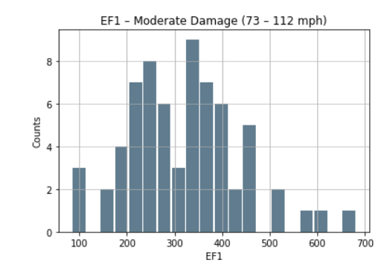
ef1
count: 67
mean: 320.37
std: 118.63
min: 84
0.25: 240.5
0.5: 324
0.75: 386
max: 682

Slide 10
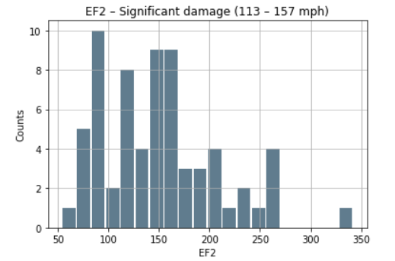
ef2
count: 67
mean: 151
std: 58.27
min: 54
0.25: 101.5
0.5: 151
0.75: 180.5
max: 342

Slide 11
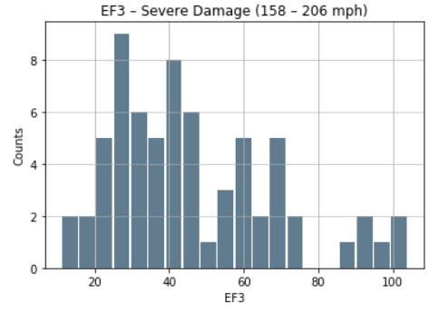
ef3
count: 67
mean: 46.46
std: 22.17
min: 11
0.25: 28.5
0.5: 41
0.75: 60.5
max: 104

Slide 12
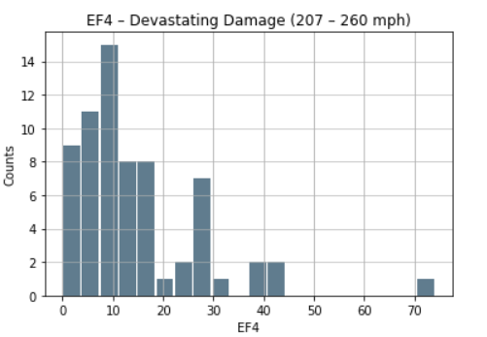
ef4
count: 67
mean: 14.63
std: 12.71
min: 0
0.25: 6.5
0.5: 11
0.75: 18
max: 74

Slide 13
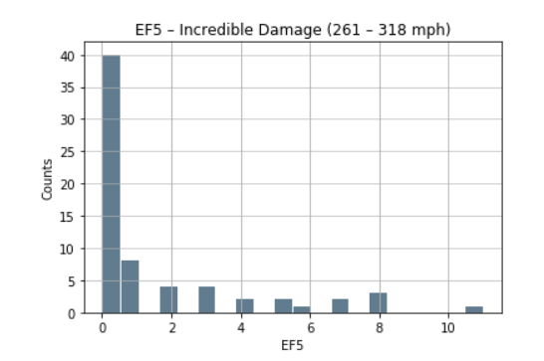
ef5
count 67.00
mean 1.51
std 2.57
min 0.00
25% 0.00
50% 0.00
75% 2.00
max 11.00
Notes:
This one had outlier out past 24, I dropped it do to the skew and kurtosis.
Skew prior: 3.55
Kurtosis prior: 16.87
Skew after: 1.92
Kurtosis after: 3.03

Slide 14
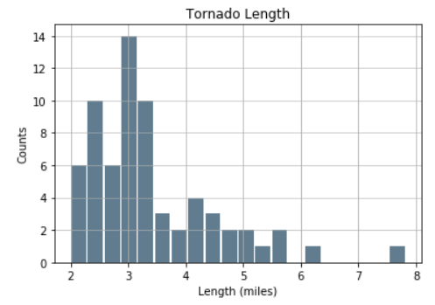
Tor_length
count: 67
mean: 3.39
std: 1.11
min: 1.99
0.25: 2.71
0.5: 3.06
0.75: 3.86
max: 7.82

Slide 15
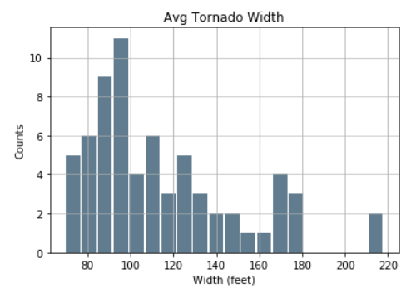
Tor_width
count: 67
mean: 114.37
std: 34.99
min: 69.52
0.25: 90.39
0.5: 104.18
0.75: 130.16
max: 217.94

Slide 16
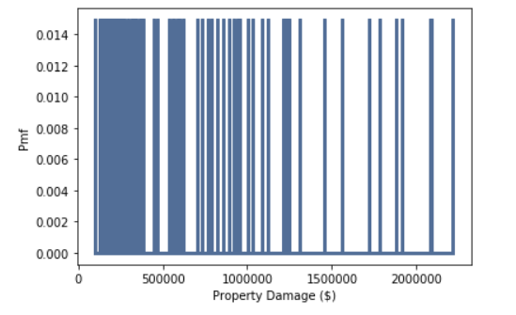
Damage_property pmf – round 1
Notes:
This was my first attempt with the damage property PMF with the aggregated values not bucketed. It is difficult to read so I decided to bucket them to see the results. This is the PMF of all of the data damage property.

Slide 17
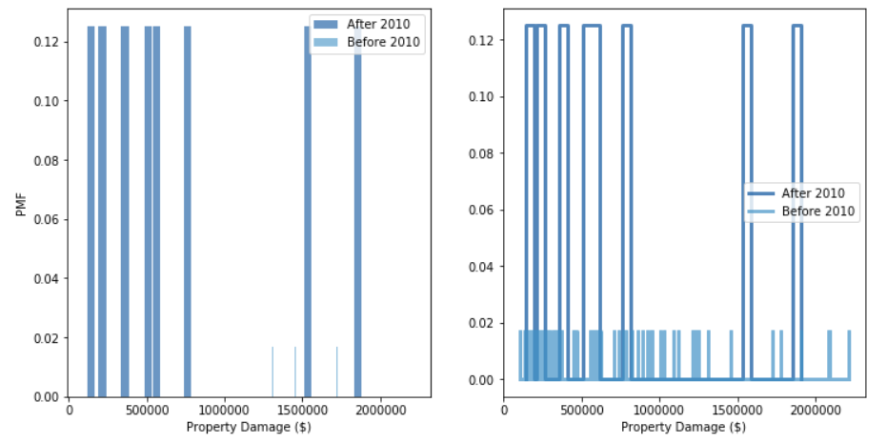
Damage_property pmf – round 1
Comparing all data prior to 2010 vs everything after 2010
Graphs are difficult to read
Seems like all values are similar in likelihood
After has less values, which causes the likelihood to increase for each value

Slide 18
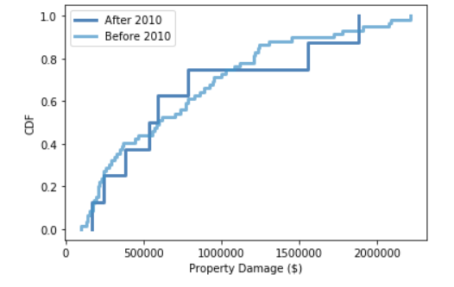
Damage_property cdf – round 1
After 2010 – more blocky due to less data
Similar in pattern
Notes:
Looking at the CDF it appear that the lines follow each other. The line “After 2010” doesn’t have as much data so it is more blocky, or its steps are bigger.

Slide 19
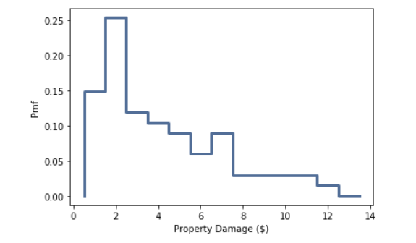
Damage_bucket pmf – round 2
Notes:
DAMAGE_PROPERTY was difficult to read so I decided to see what it would like place them in bins.

Slide 20
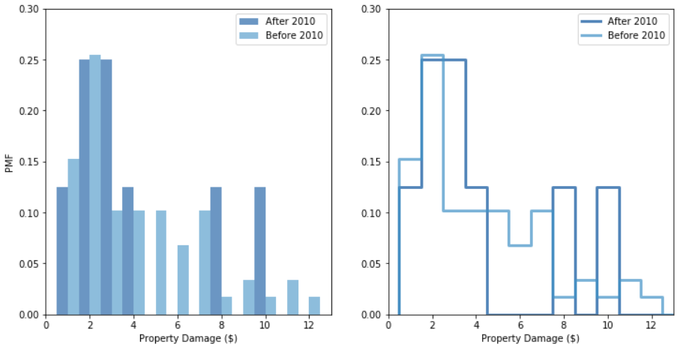
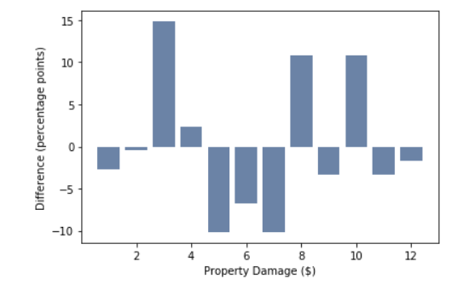
Damage_property pmf – round 2
Easier to compare data
After has less values still
Notes:
Notice how the graphs are easier to compare now. There are more values coming from “Before 2010” still, but that is due to that having more data points. Distributions seems similar, weighted heavily weighted to the left with a tail to the right. There some higher peaks at 8 and 10. The bottom graph with difference (percentage points), represents the difference between the two points. If points are positive, this represents values “After 2010” having more values. There are 4 on the “After 2010” side and 7 on the “Before 2010”.

Slide 21
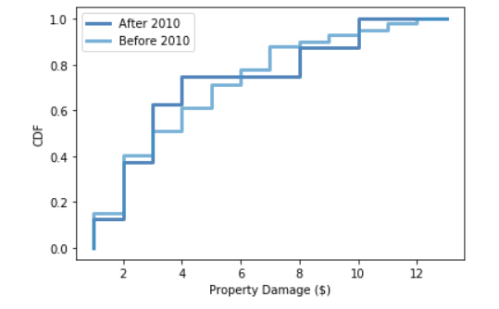
Damage_property cdf – round 2
“Before 2010” following same pattern with bigger steps
“After 2010” less steps more smooth
Notes:
Similar results as round 1, but easier to compare results, based on how blocky the results are.

Slide 22
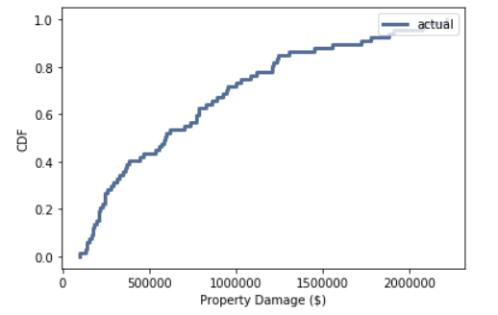
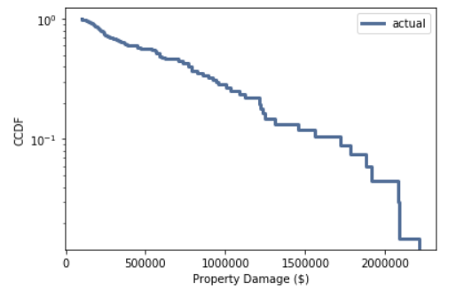
Exponential distribution on damaged_PROPERTY
CDF
CCDF
Notes:
It appears that the exponential function fits the DAMAGED_PROPERTY data. Notice how it follows that bowed out curve. The ccdf seems to follow the straight line as well on the log y scale.

Slide 23
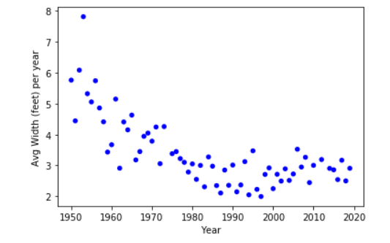
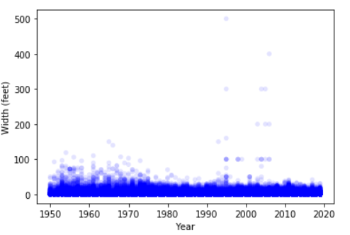
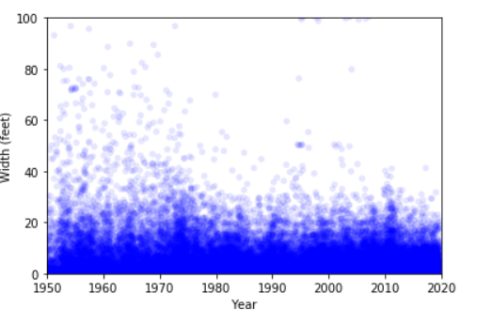
Correlation between year and tor_length
0.008008888815100956
Avg . Tornado length per year
Raw Tornado length
Raw Tornado length zoom
Pearson correlation: -0.70892305
Spearman: -0.698699018277596
Transformed with log correlation: -0.7125315901211206
Pearson correlation: -0.08890348
Spearman: 0.10193580487255906
Transformed with log correlation: -0.008008888815100956
Notes:
For the correlation piece I am looking at both the aggregated data as well as the raw data. I was interested to see how closely the follow each other. The graph on the left with the aggregated data seems have strong negative relationship. The middle graph is difficult to tell, and the far right it looks like there could be a weak relationship, but still a negative correlation.
The correlation was calculated for the aggregated data. All three values show a strong negative relationship. Meaning that as time goes on the length of tornadoes seem to get smaller based on the dataset.
The correlation for the raw data shows that they is not a strongly correlated at all. We have two negative values and one positive. It looks like this is happening because the left side of the graph has a few more points that show a tornadoes length above 60 happening more often. Might be due to technology now compared to back in the 50’s until now.

Slide 24

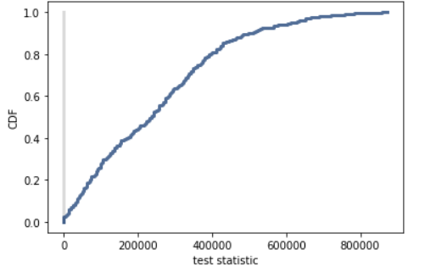
Comparing the means
Ho – mean property damage prior to 2010 = mean property damage after 2010
Ha – they don’t equal
Two-sided tail p-value = 1
Hypothesis testing
Notes:
Based on our assumptions we cannot conclude that the means are equal, with a p-value of 1.

Slide 25
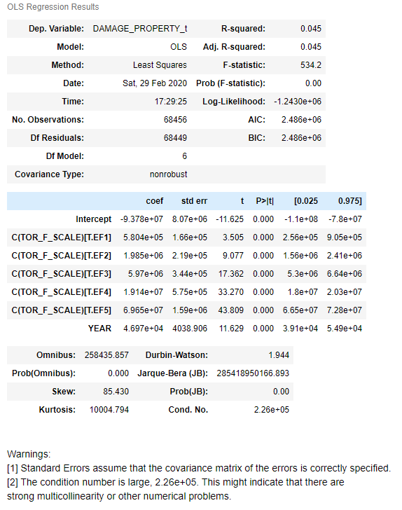
Multi-linear regression
DAMAGE_PROPERTY_t ~ YEAR + C(TOR_F_SCALE)
Not a good fit
Potential multicollinearity
F-statistic is high
Low R-squared value (.045)
YEAR AND TOR_F_SCALE ONLY CONTRIBUTE 4.5% VARIATION ON DAMAGE_PROPERTY_t
Notes:
I used the raw data for this. DAMAGE_PROPERTY_t is used to transform the raw data (EX. 12k to 12,000). Notice that the p-values are all zero, and there is a warning for multicollinearity. The F-statistic is high, meaning we the model is not valid. R-squared is low contributing a minimal amount of variation on DAMAGE_PROPERTY_t based on YEAR and TOR_F_SCALE.

Slide 26
Conclusion
Notes:
I believe there are things that I am missing here. The regression model failed, but I think if we were to add more variables it would help. I think adding more variables like time, location, duration, death, injuries would help as well. I think adding more data from other sources could really help as well. Understanding how and when to appropriately transform the data may have helped the analysis as well. It seems like there are some things happening among the data, just waiting to be found.

